Slide 1


Analysis of RAI14 Knockout PDAC Cell Derivatives by CycIF (Cyclic Immunofluorescence)
Analysis of RAI14 Knockout PDAC Cell Derivatives by CycIF (Cyclic Immunofluorescence)
Fix Cells
Stain for biomarkers
Image
Deactivate Fluorophores
Prepare image files
Analyze images
Extract data
Perform dimensionality reduction

Slide 2
Biomarker | Expression Indicates | Citation
p-Akt | mTOR phosphorylation & gemcitabine resistance | Kagawa et al., 2012, Journal of Surgical Research.
p-Rb | normal or oncogenic CDK activity (depending on localization) | Jiao et al., 2008, Oncogene.
Mcl1 | apoptosis prevention | Chen et al., 2013, Molecular Cancer.
Ki67 | mitosis | Pantanowitz & Gurcan, 2018, PloS One.
p-s6 | mTOR activity | Khalaileh et al., 2013, Cancer Research.
Vimentin | mesenchymal cell state | Yamada et al., 2013, Surgery.
KDEL (GRP78) | stemness | Dauer et al., 2019, Cell Death & DIsease.
FOXO1A | Akt pathway activity | Boreddy et al., 2011, Clinical Cancer Research.
p-Stat3 | proliferation | Jahny et al., 2017, PloS One.
PCNA | proliferation | Smith et al., 2020, Molecular Therapy – Oncolytics.
PD-L1 | immune system regulation | Inaguma et al., 2017, The Journal of Pathology: Clinical Research.
NFκBp65 | apoptosis regulation | Baldwin, 2001, The Journal of Clinical Investigation.
E-Cadherin | epithelial cell state | Yamada et al., 2013, Surgery.
SOX2 | stemness | Wuebben et al., 2016, Oncotarget.
Bim | apoptosis | Burmi et al., 2018, Cancer Biology & Therapy.
p-γH2AX | DNA repair | Burrage et al., 2012, Journal of Cell Science.
Notes:
KDEL antibody was not available October’s CycIF experiment.

Slide 3
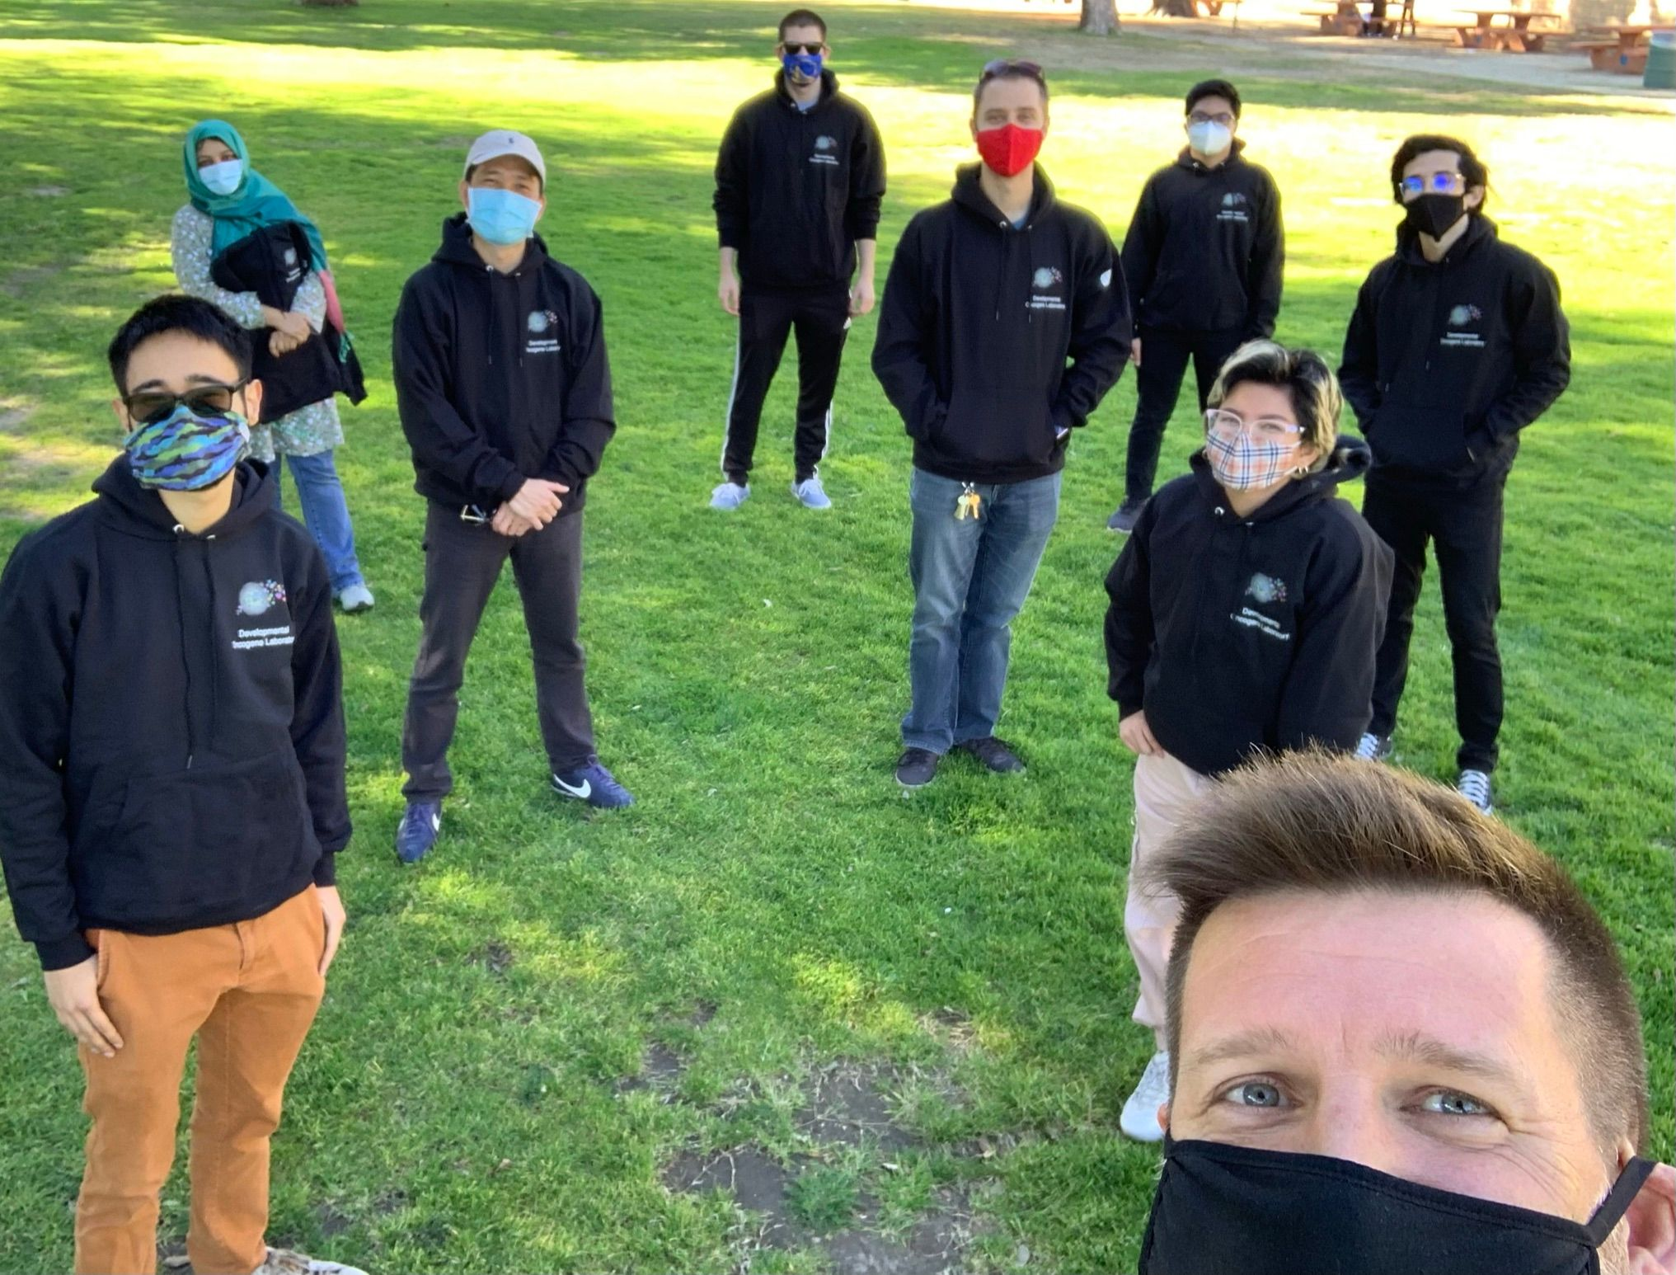




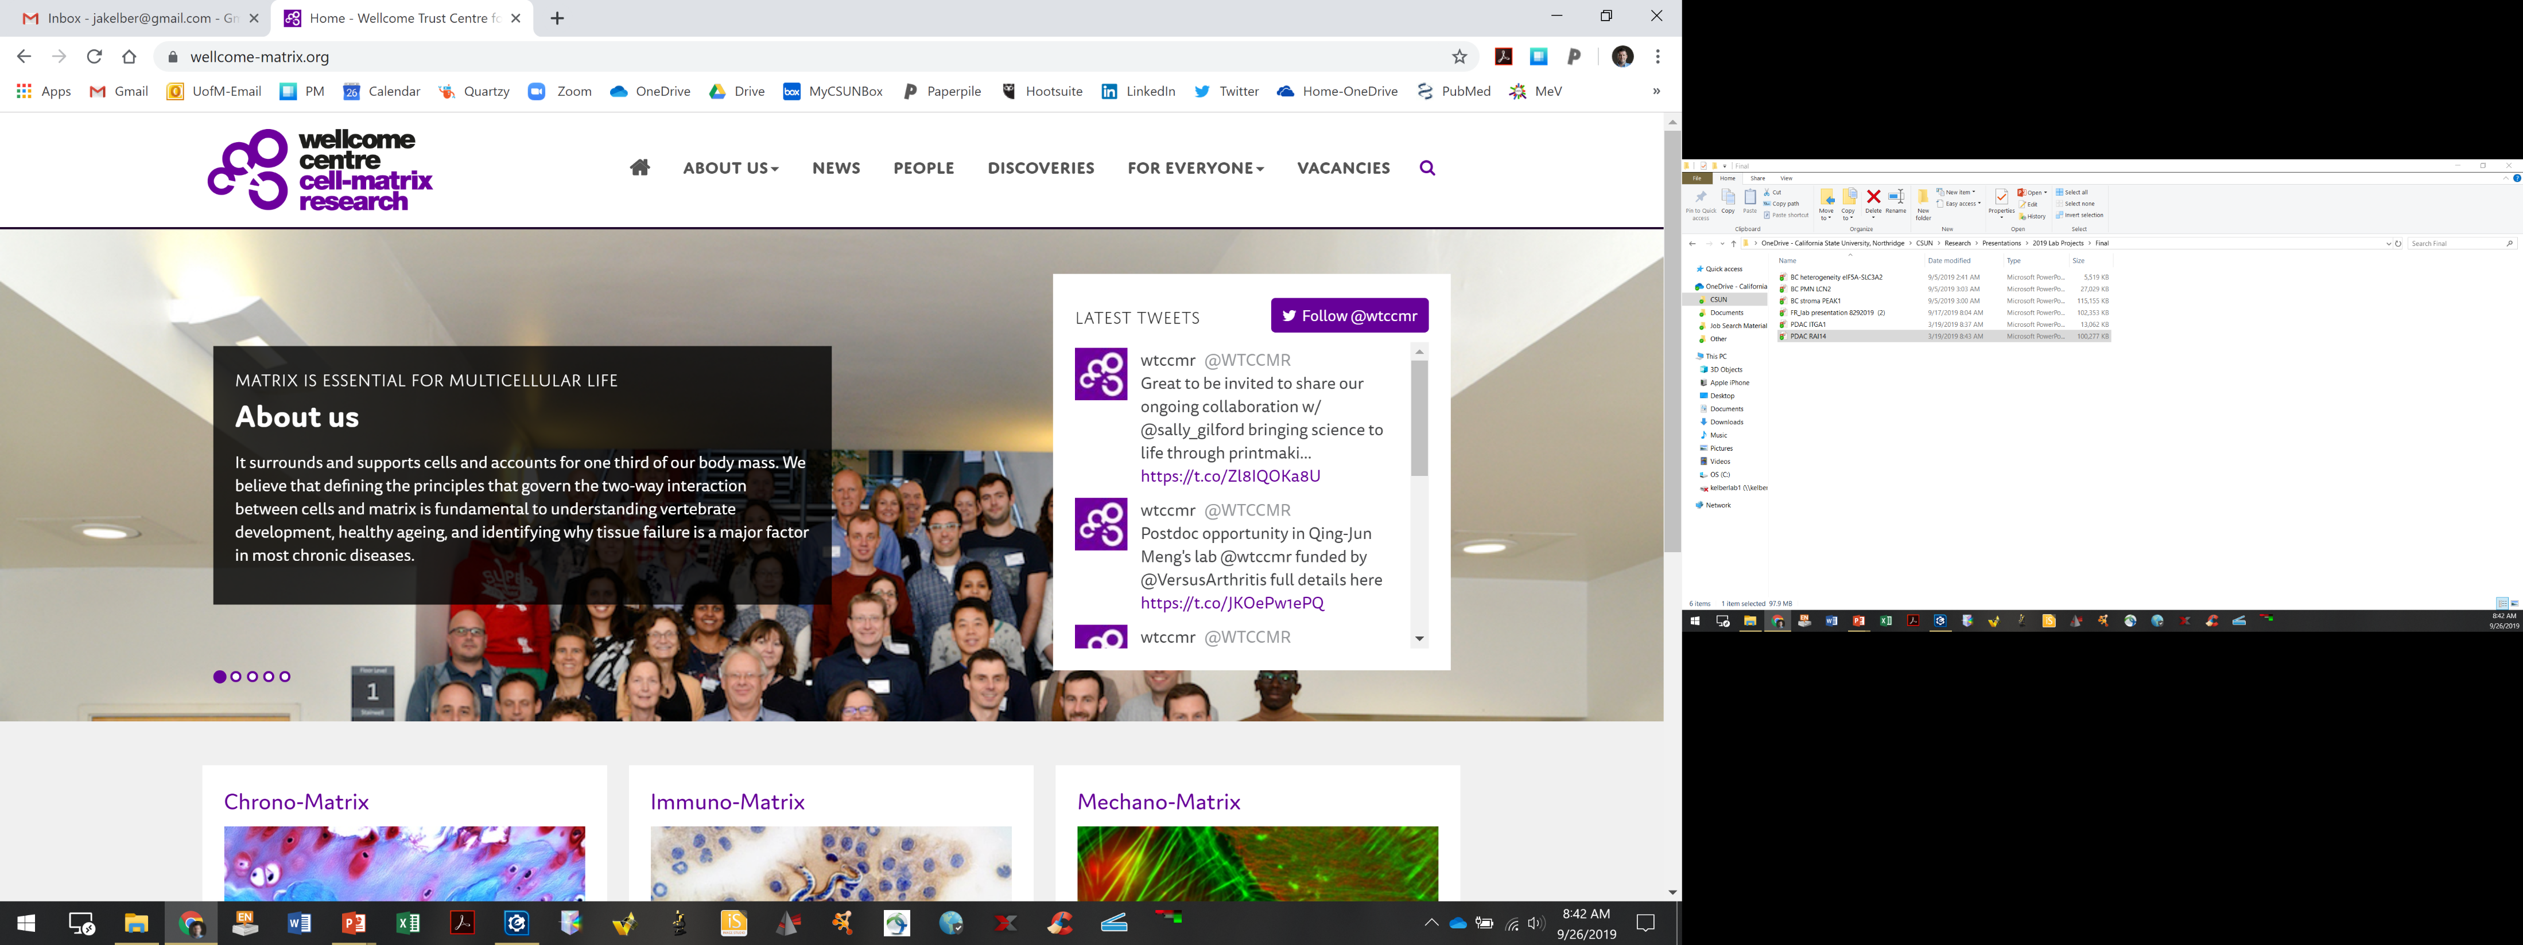




Acknowledgements
Developmental Oncogene Laboratory
Funding
Dr. Gary and Vera Sutter

